Slide 1
Jpeg Decoder
Baseline Sequential DCT-based

Slide 2
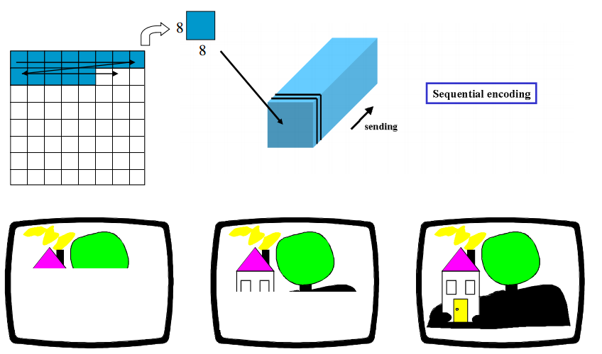
Baseline Sequential DCT-based

Slide 3
Baseline Sequential DCT-based Encoding Process
Color Space Conversion
Subsampling
Partition
Encoding Flow Control
Discrete Cosine Transform (DCT)
Quantization
Entropy Encoding (Huffman)
Decoding

Slide 4
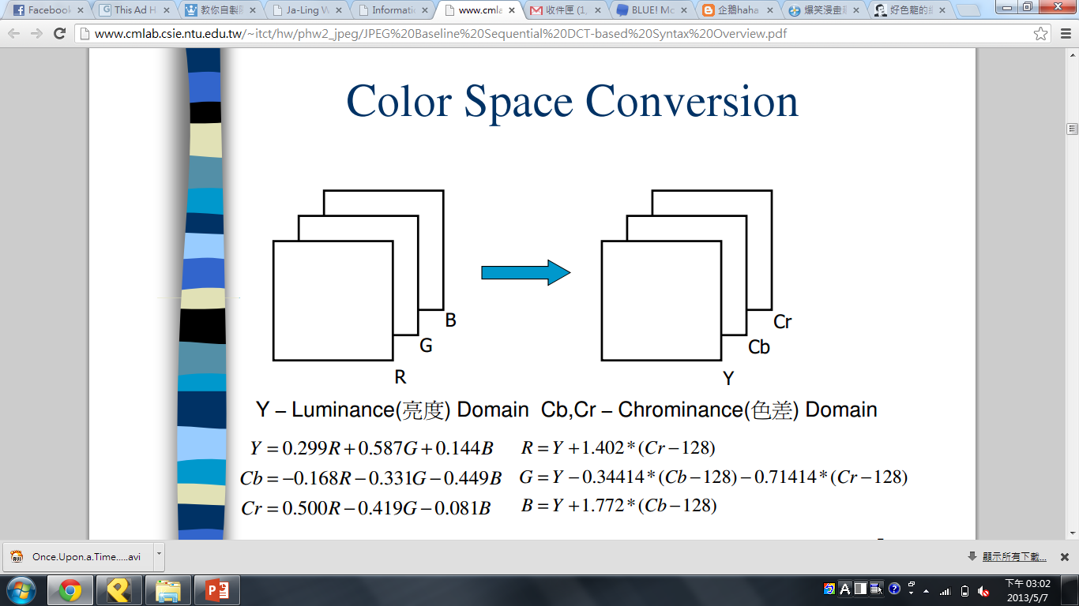


RGB
YCbCr

Slide 6
Baseline Sequential DCT-based Encoding Process
Color Space Conversion
Subsampling
Partition
Encoding Flow Control
Discrete Cosine Transform (DCT)
Quantization
Entropy Encoding (Huffman)
Decoding

Slide 7
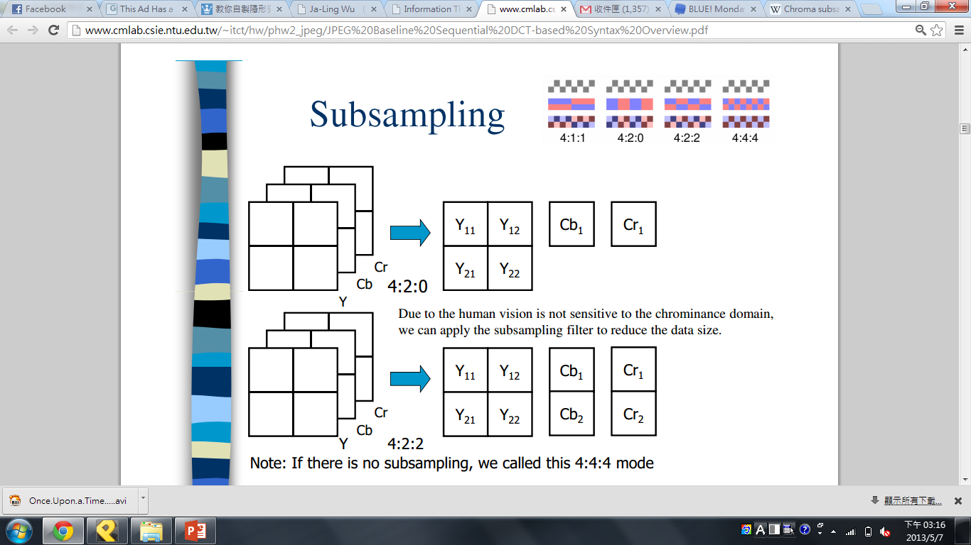

Slide 8
Baseline Sequential DCT-based Encoding Process
Color Space Conversion
Subsampling
Partition
Encoding Flow Control
Discrete Cosine Transform (DCT)
Quantization
Entropy Encoding (Huffman)
Decoding

Slide 9
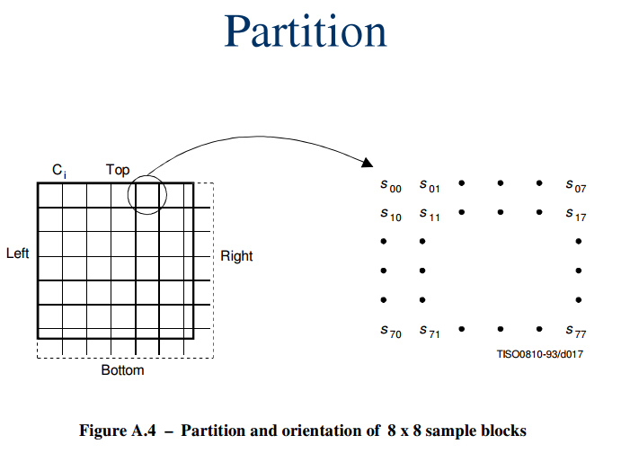

Slide 10
Baseline Sequential DCT-based Encoding Process
Color Space Conversion
Subsampling
Partition
Encoding Flow Control
Discrete Cosine Transform (DCT)
Quantization
Entropy Encoding (Huffman)
Decoding

Slide 11
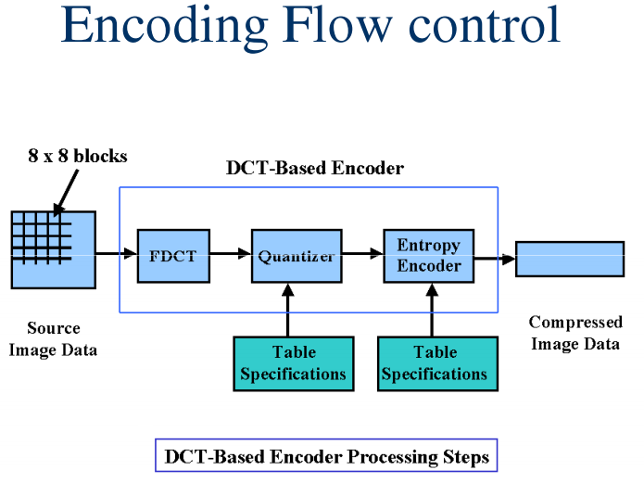

Slide 12
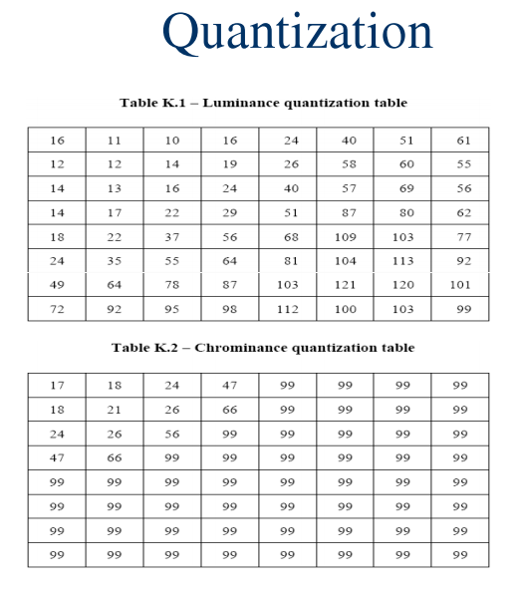

Slide 14
Huffman Encoding
DC Diff
AC Run-Length pair

Slide 15
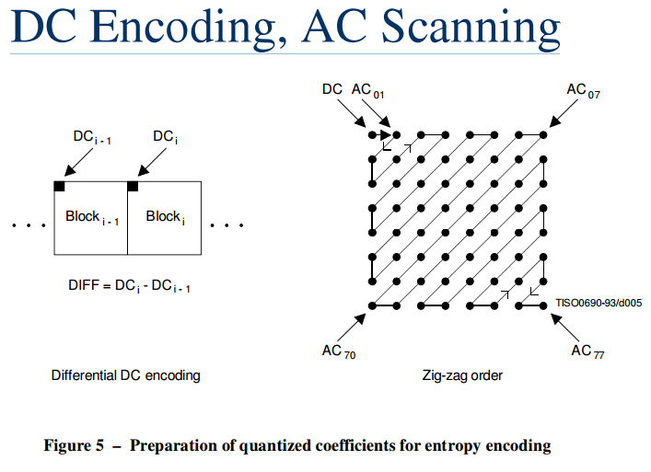

Slide 16
DC Diff
(ITU-T81 Annex F)
SSSS | DIFF values
0 | 0
1 | –1,1
2 | –3,–2,2,3
3 | –7..–4,4..7
4 | –15..–8,8..15
5 | –31..–16,16..31
6 | –63..–32,32..63
7 | –127..–64,64..127
8 | –255..–128,128..255
9 | –511..–256,256..511
10 | –1 023..–512,512..1 023
11 | –2 047..–1 024,1 024..2 047
Decoding codeword with Huffman decoding for getting SSSS
Using following SSSS bits as index for looking up DIFF value
Plus the DC value of last block

Slide 17
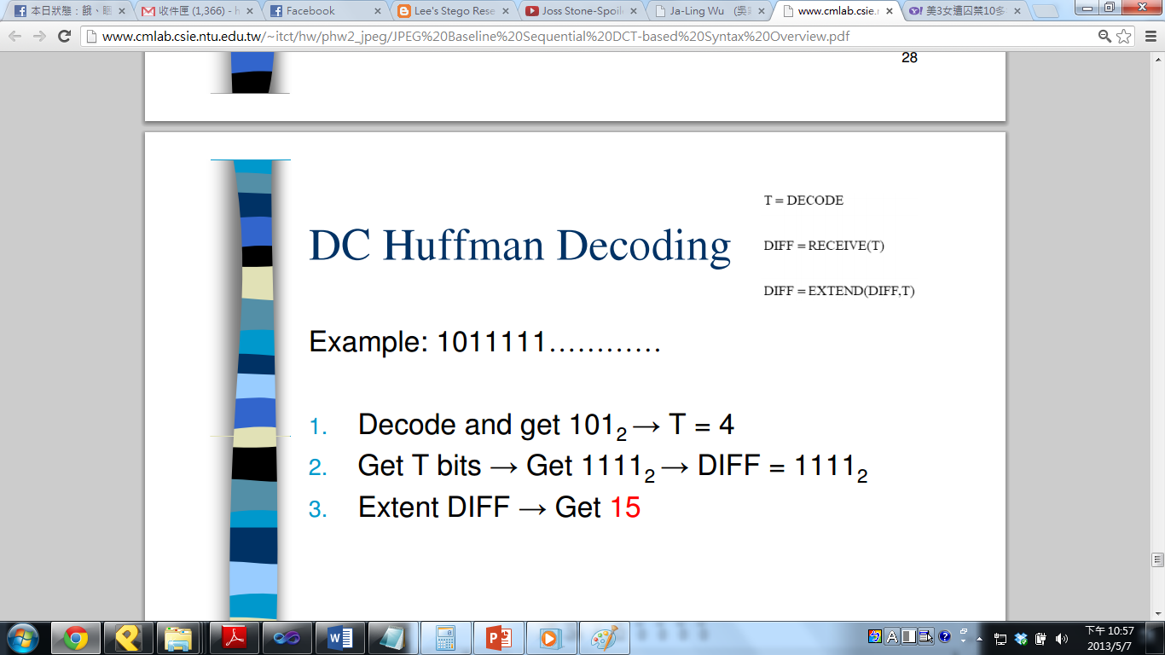
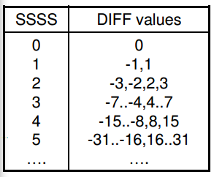
Huffman decoding

Slide 18
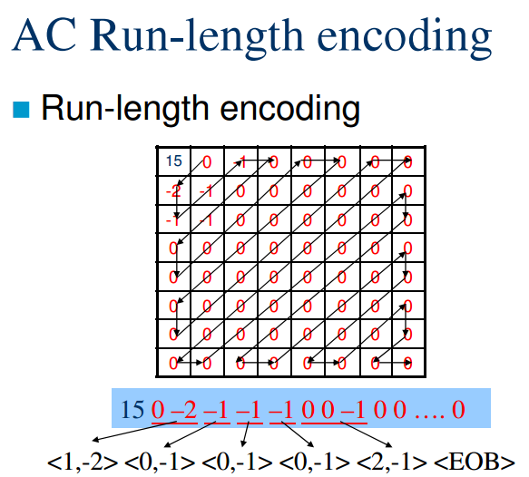

Slide 19
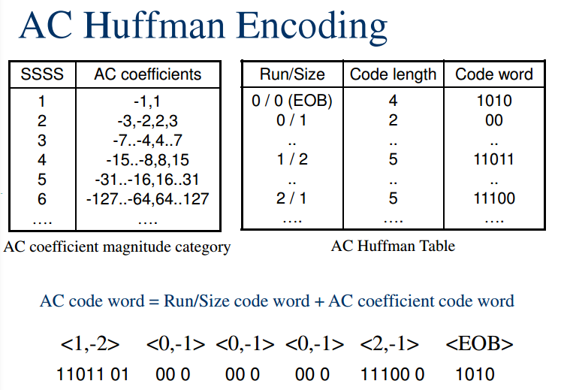
RRRRSSSS

Slide 20
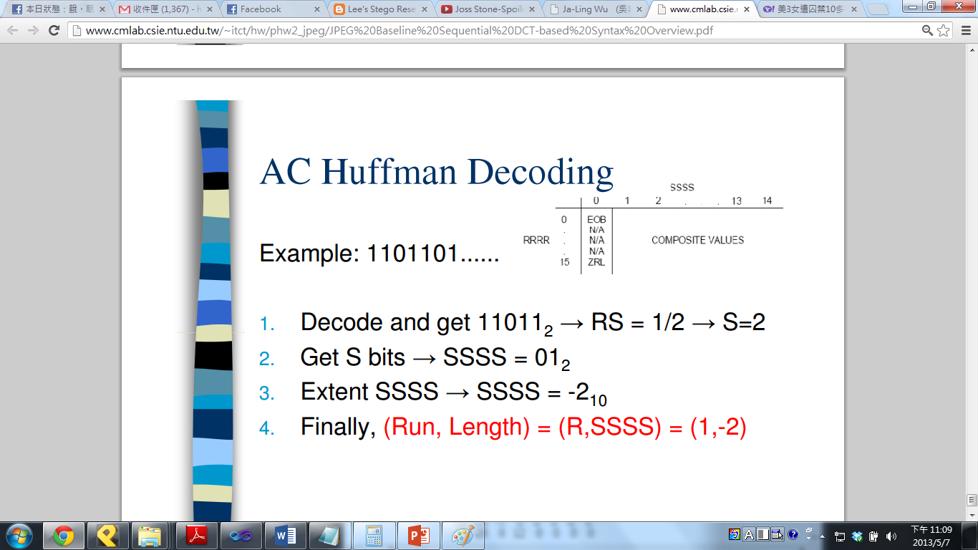
Huffman decoding

Slide 21
Header Processing
Important header

Slide 23
Code Assignment | Symbol | Description
Start Of Frame markers, non-differential, Huffman coding
X’FFC0’ | SOF0 | Baseline DCT
Huffman table specification
X’FFC4’ | DHT | Define Huffman table(s)
Restart interval termination
X’FFD0’ through X’FFD7’ | RSTm* | Restart with modulo 8 count “m”
Other markers
X’FFD8’ X’FFD9’ X’FFDA’ X’FFDB’ X’FFDD’ X’FFE0’ through X’FFEF’ | SOI* EOI* SOS DQT DRI APPn | Start of image End of image Start of scan Define quantization table(s) Define restart interval Reserved for application segments

Slide 24
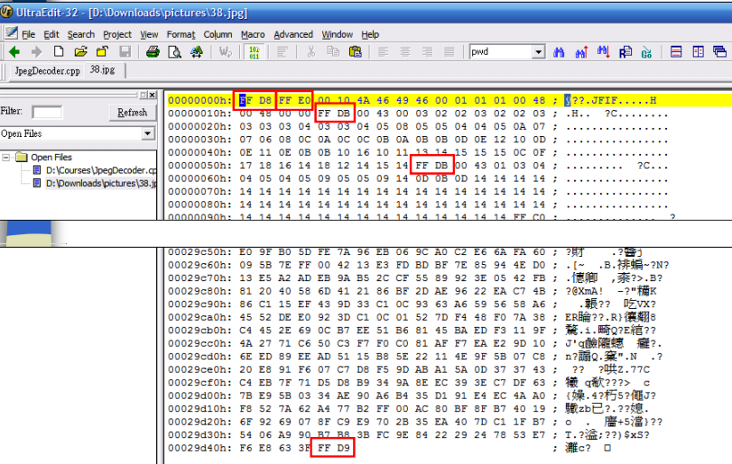

Slide 25
Header Structure
(ITU-T81 Annex B)
Marker
Number of components
Information

Slide 26
SOF
Ci: Component identifier
Hi: Horizontal sampling factor
Vi: Vertical sampling factor
Y: Number of lines
X: Number of samples per line

Slide 27
Parameter | Size (bits) | Sequential DCT |  | Progressive DCT | Lossless
 |  | Baseline | Extended
Lf | 16 | 8 + 3* Nf
P | 8 | 8 | 8, 12 | 8, 12 | 2-16
Y | 16 | 0-65535
X | 16 | 1-65535
Nf | 8 | 1-255 | 1-255 | 1-4 | 1-255
Ci | 8 | 0-255
Hi | 4 | 1-4
Vi | 4 | 1-4
Tqi | 8 | 0-3 | 0-3 | 0-3 | 0-1

Slide 28
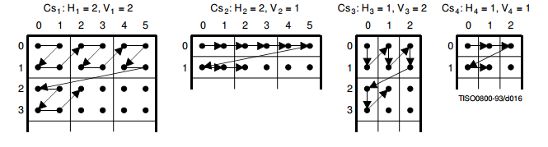
MCU – Minimum Coded Unit, which is comprised by blocks from each component
In 4:2:0 mode, there are 6 blocks
(2*2+1*1+1*1) in an MCU.

Slide 29
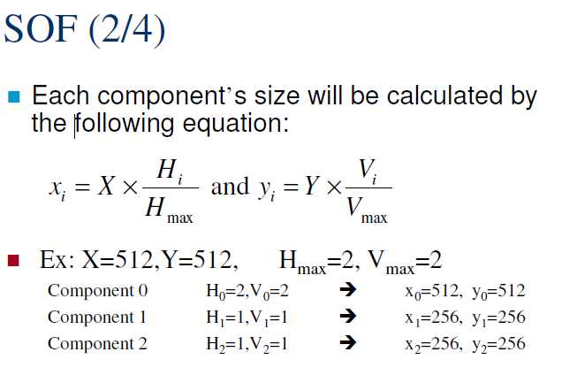

Slide 30
SOS
Ns: Number of image components in scan
Tdj: DC entropy coding table destination selector
Taj: AC entropy coding table destination selector

Slide 31
 |  | Values
Parameter | Size (bits) | Sequential DCT |  | Progressive DCT | Lossless
 |  | Baseline | Extended
Ls | 16 | 6 + 2 * Ns
Ns | 8 | 1-4
Csj | 8 | 0-255
Tdj | 4 | 0-1 | 0-3 | 0-3 | 0-3
Taj | 4 | 0-1 | 0-3 | 0-3 | 0
Ss | 8 | 0 | 0 | 0-63 | 1-7
Se | 8 | 63 | 63 | Ss-63 | 0
Ah | 4 | 0 | 0 | 0-13 | 0
Al | 4 | 0 | 0 | 0-13 | 0-15

Slide 32
DQT
Tq: Quantization table destination identifier
- o for DC 1 for AC
Qk: Quantization table element

Slide 33
 |  | Values
Parameter | Size (bits) | Sequential DCT |  | Progressive DCT | Lossless
 |  | Baseline | Extended
Lq | 16 |  |  |  | Undefined
Pq | 4 | 0 | 0, 1 | 0, 1 | Undefined
Tq | 4 | 0-3 |  |  | Undefined
Qk | 8, 16 | 1-255, 1-65535 |  |  | Undefined

Slide 34
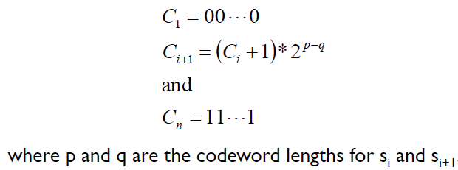
DHT
(codeword)
Tc: Table class, DC or AC?
Th: Huffman table destination identifier
Li: Number of Huffman codes of length i
Vi,j: Value associated with each Huffman code
(length)
(symbol)

Slide 35
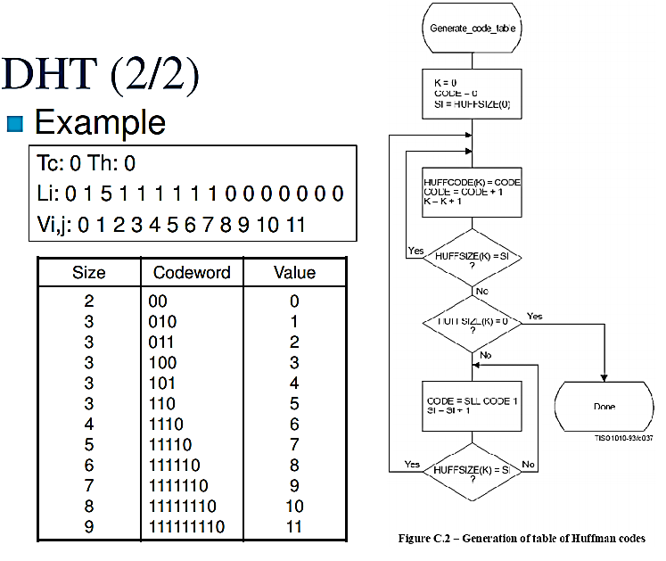
(ITU-T81 Annex C)

Slide 36
In common case, there are four huffman tables:
– Luminance’s DC huffman table
– Luminance’s AC huffman table
– Chrominance’s DC huffman table
– Chrominance’s AC huffman table

Slide 37
 |  | Values
Parameter | Size (bits) | Sequential DCT |  | Progressive DCT | Lossless
 |  | Baseline | Extended
Lh | 16
Tc | 4 | 0, 1 |  |  | 0
Th | 4 | 0, 1 | 0-3
Li | 8 | 0-255
Vi, j | 8 | 0-255

Slide 38
DRI
Ri – Specifies the number of MCU in the restart interval.
After the number of MCU reaches Ri, a RST marker is inserted and the MCU counter is reset.
You can resynchronize to the next RST marker when bit error or packet loss occurred during image transmission and the number of lost MCU can be known from the difference of RST id.

Slide 39
Other Marker
APP, COM, DNL, DHP, EXP …
Skip it by using the length field after the marker

